Slide 1




GREY CELLS
Milin Jaiswal
Lakshmi Narasiman
Saumya Soman

Slide 2
Why WHAT HOW ? Really ?
Intelligent
Networks
Applications
Applications
Applications
Control Plane
Data Plane

Slide 3
Hackathon : Problem Statement
Network
Visualize
Controller
Scenarios

Slide 4
Our Approach – A Thought
Network
(Save Me !)
Network is Perfect ? Really is it ?
But no one is perfect in this world.
Why don’t I ask the Network directly ?
Server
CLIENT
Application

Slide 5
Our Approach - Design
Network
( now I have some hope ! )
Controller
Client – Server FTP Application
with
Mr. X (Controller)
Server
CLIENT
Application

Slide 6
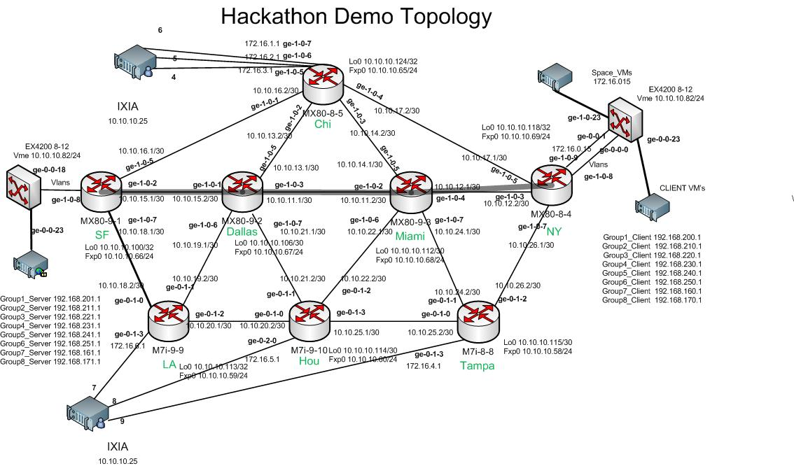
Our Approach – Implementation
Server
Server

Slide 7
Implementation : Flow
FTP Server Starts
FTP Client Starts – Menu Driven
FTP Client Application calls the controller module.
Controller module computes most Idle Lsp and Sends the LSP Destination of this Lsp to FTP Client Application
FTP Client connects to Server via “Socket pointing” , this LSP destination ISP over its predefined port & downloads/uploads the file

Slide 8
Implementation : Flow
1. Server IP
2. Destination IP of Lsp
Input / Output Streams
Server
3. Socket to Server
4. Output Stream of Client

Slide 9
How the controller thinks
Gets list of Lsp(s) from the Gateway Router.
For each Lsp, filters them for the required Server IP requested by client.
It gets the Bandwith of each interface in the LSP(s) + Connections of the interfaces
The minBandwith(LSP) = Min-Max Algo.

Slide 10
Solution : Scalabilty Vs Possibility
Intelligent
Networks
Intelligent Applications
Intelligent Applications
Intelligent Applications

Slide 11
THANKYOU ….

